Slide 1
Spatio-Temporal Naive-Bayes Nearest- Neighbor (ST-NBNN) for Skeleton- Based Action Recognition
Junwu Weng, Chaoqun Weng, Junsong Yuan

Slide 2
Outline
Spatio-Temporal-NBNN applies stage-to-class distance to classify actions by using non-parametric methods.
It takes the spatio-temporal structure of 3D actions into consideration.
It adopts bilinear classifiers to identify key temporal stages and spatial joints.
It can achieve competitive performance compared with deep learning models by combining the strength of both non-parametric and parametric models.
It can capture the essential spatio-temporal patterns by identifying key skeleton joints and temporal stages for each action class.

Slide 3
Introduction
Non-parametric methods, like Naive-Bayes Nearest-Neighbor (NBNN), do well in classifying images by using image-to-class distance.
Motivation:
1) Similar to images, composed by local visual primitives, actions are composed
by spatio-temporal primitives (Each action instance is a collection of skeleton
poses and each pose is further a collection of spatial joints).
2) Compared with images composed of millions or billions of pixels, the skeleton is
composed by only tens of joints which is thus of much less complexity than
images and videos.

Slide 4
Introduction
Each 3D action instance is represented by a collection of temporal stages composed by 3D poses, and each pose in stages is presented by a collection of spatial joints.
We present stage-to-class distances as a spatio-temporal matrix of NN distances which represents the action instance.
ST-NBNN adopts a bilinear classifier to identify key joints and stages and classify the spatio-temporal matrix of NN distances.
ST-NBNN can capture the essential spatio-temporal patterns for each action class, and provide a physical interpretation of the action behavior.

Slide 5
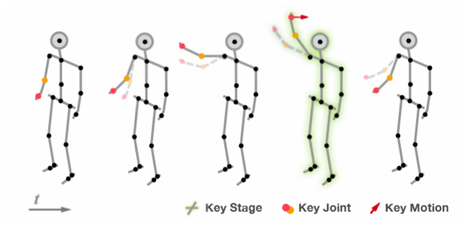
Introduction
An Illustration of Key Stage, Joints, and Motion for the action of waving right hand action
(When performing right hand waving action, only the right hand and arm [key joints] are activated. And when observing the timing [key stage] at which the right hand and arm raise up and move horizontally towards left, we can claim that waving right hand action is performing).

Slide 6
Method
3D Action Representation
An action video is uniformly divided into a ﬁxed number of stages, and is represented by a set of stage-descriptors (orange query points);
Distances of stage-descriptors to action class sets (blue, green and red) are calculated by NN search;
Distances of stage-descriptors are gathered in temporal order to generate class-related squared distance matrices (marked by class-related dashed rectangular boxes);
Weights on the spatial (left side of the matrix) and the temporal (top of the matrix) domain are learnt to discover key factors of actions and predict action labels.

Slide 7
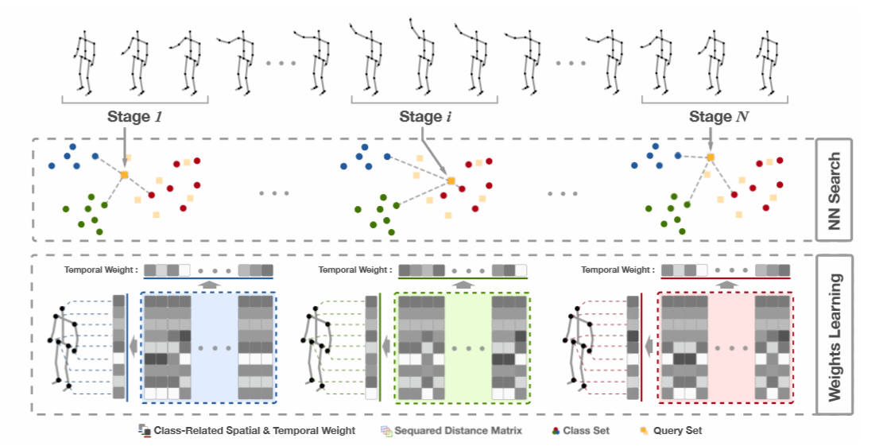
Method
3D Action Representation

Slide 8



Method
3D Action Representation
Assuming each 3D pose has J joints for its skeleton, for a temporal stage descriptor X, the 3D pose in its j-th frame is denoted as Pj, and the related velocity of that pose is denoted as Vj.
Then the pose part Xp and the velocity part Xv of X is deﬁned as below,
a temporal stage descriptor X of L frames is presented as:
a 3D action video is described by its N stage descriptors V:

Slide 9

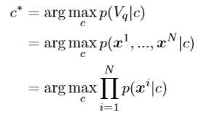

Method
NBNN
Given a query action video Vq, NBNN’s goal is to ﬁnd which class c ∈ {1,2,...,C} the video Vq belongs to.
When assuming equal prior p(c) = 1/C , the predicted class is:
With the Naive-Bayes assumption, it can be written as,
The probability density of each primitive x in a class c
can be re-written as,
, where NNc(Xi) is the nearest neighbor of Xi in class c.

Slide 10

Method
Spatio-Temporal NBNN
Identify important spatial joints and temporal stages simultaneously, as well as learn spatio-temporal weights
Spatio-temporal Matrix
The nearest neighbor matrix of X in c as XcNN = [NNc(x1), ... ,NNc(xN)], the squared distance matrix to class c is deﬁned as,
, where ⊙ is an element-wise product.

Slide 11
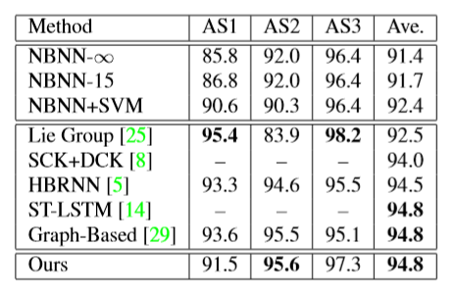
Experiment Results and Analysis
MSR-Action3D
Comparison of Results on MSR-Action3D (%)

Slide 12
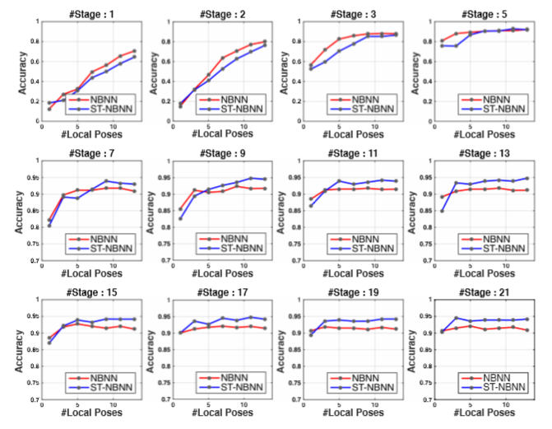
Experiment Results and Analysis
MSR-Action3D
Parameter Sensitivity
Analysis on MSR-Action
Dataset. The x-axis
indicates the chosen
number of local poses.
The subtitle indicates
the chosen number
of temporal stages.

Slide 13
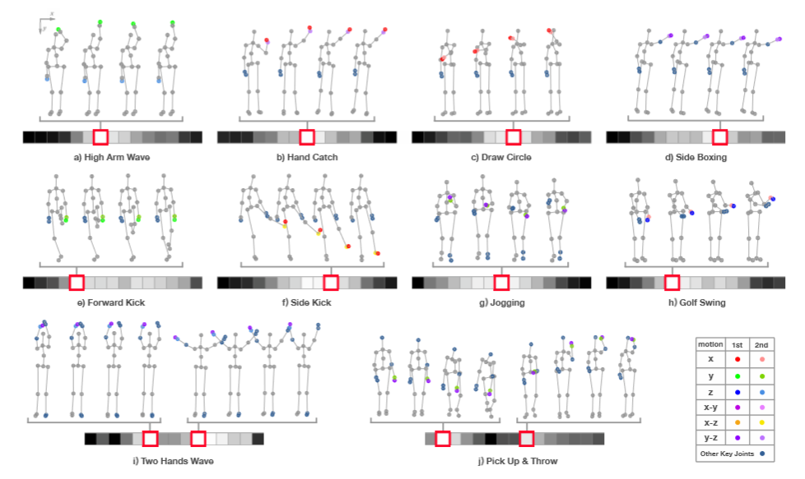
Experiment Results and Analysis
MSR-Action3D
Key Stages and
Key Joints with
their Key
Motions from
MSR-Action3D.
Notes:
Colored joints are with weights larger than average weights. The most informative joints are marked by bright color, and the second most informative joints are marked by light color. The global key motions are indicated by different colors. For example, the key motion directing in the x direction is colored by bright red for the 1st most informative joint, and by light red for the 2nd most informative joint. Only the motion of 1st and 2nd key joints are marked. The temporal weights for each action are shown as gray images. Each square in that image represents a temporal stage. The whiter the square, the higher the temporal weight. The key stage is highlighted by a red box. We illustrate each key stage using its 4 representative 3D poses. The bottom two actions have two key stages each.

Slide 14
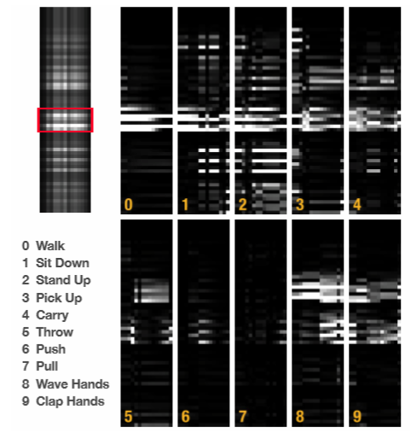
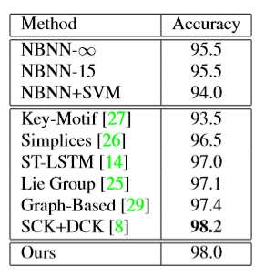
Experiment Results and Analysis
UTKinect
Comparison of Results on UTKinect (%)
An Example of Spatio-Temporal Weight Matrix and Squared Distance Matrix (One pose feature of Pull Action).
Notes:
ST-Weight Matrix is on the top-left corner, and squared distance matrices are on the right side. Each matrix is 60 by 15. The related feature of discovered joints are marked by red box.

Slide 15
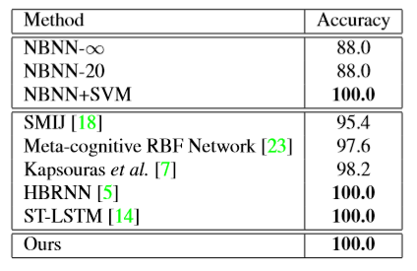
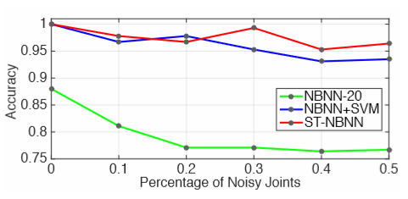
Experiment Results and Analysis
Berkeley MHAD
Inﬂuence of Noisy Joints on Accuracy of Berkeley MHAD Dataset
Comparison of Results on Berkeley MHAD (%)

Slide 16
Conclusion
ST-NBNN considers the spatio-temporal structure of 3D actions and combines the strength of both non-parametric model and also parametric model.
ST-NBNN can discover critical spatial joints and temporal stages, which are essential to capture the spatio-temporal patterns of 3D actions.
ST-NBNN demonstrates the potential of using non-parametric method for skeleton-based action recognition.

